Slide 1





Knapsack
Problem
Ajinkya Walunj (12110283)
Akash Bhandari(12111450)
Aneesh Dighe(12110353)
Anish Sagri(12110206)
Faculty: Dr. Pushkar Joglekar

Slide 2



Introduction
Optimization problems are common challenges in various fields.
The knapsack problem involves choosing items with different values and weights to fit into a limited-capacity "knapsack."
This problem is crucial in resource allocation, finance, and logistics for making optimal decisions with constrained resources.

Slide 3



Knapsack?
12 Kg
12 Kg
2$
10Kg
4$
8Kg
12 Kg
2 Kg
The Knapsack problem is a classic optimization challenge.
It involves a "knapsack" with limited capacity.
Items with varying weights and values/profits are available.
The objective is to select items to maximize value or profit without exceeding the knapsack's capacity.
15 Kg
10$
5 Kg

Slide 4

Types
Fractional Knapsack Problem
0/1 Knapsack Problem

Slide 5
Fractional Knapsack Problem
It involves selecting items from a set with given weights and values to maximize total value while not exceeding a knapsack's weight limit.
Brute-force and dynamic programming approaches fail in the fractional knapsack problem due to their exponential complexity when considering all possible combinations of items.
In dynamic programming approach You would need to consider all possible fractions for each item, significantly increasing the number of subproblems and the computational burden.

Slide 6
Greedy Approach
Calculate the value-to-weight ratio for each item.
Sort the items in decreasing order of their value-to-weight ratio.
Initialize the total value and an empty knapsack.
Add items to the knapsack one by one, starting with the highest ratio, until the knapsack is full.
Return the total value of the items in the knapsack as the optimal solution.

Slide 7
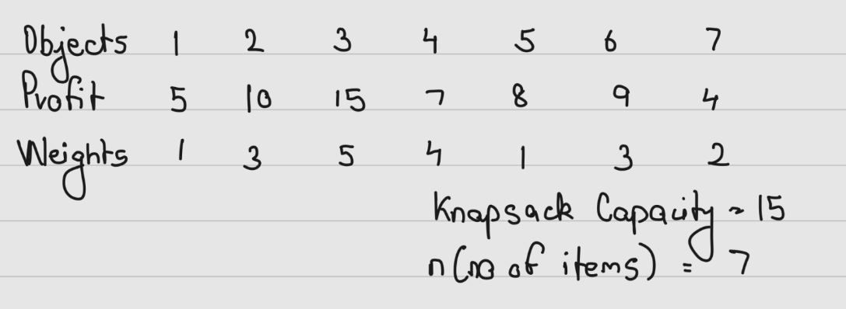
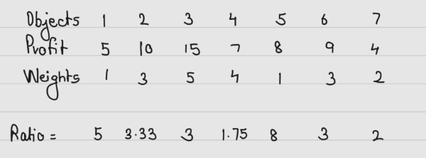

Slide 8
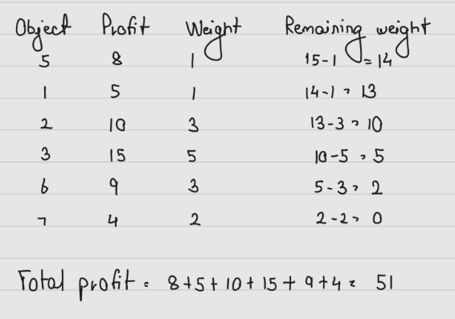

Slide 9
0/1 Knapsack Problem

Slide 10
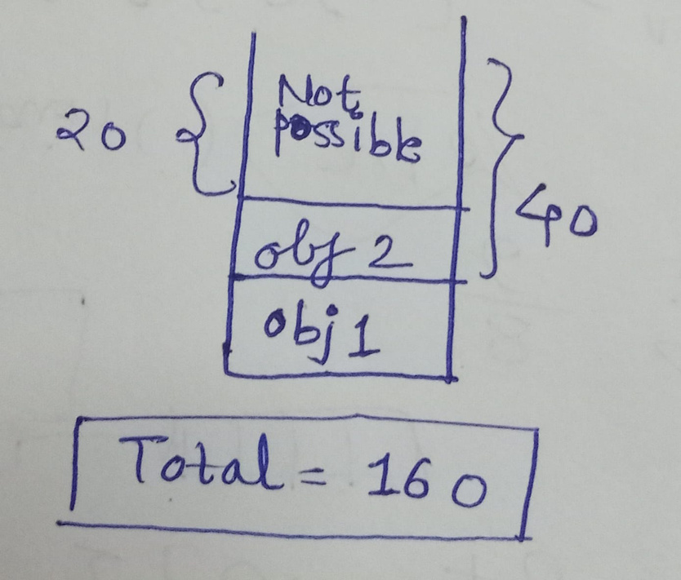
Let us try Greedy
Lets us be greedy on profit/weight ratio
M = 50
Objects | 1 | 2
Profit | 60 | 100
Weight | 10 | 20
3
120
30
P/W 6 5 4

Slide 11

Why Greedy wont give optimal solution
We are not allowed to put fraction of object in knapsack
No uniformity
No proper relation between weight and profit
3. We opt for trying all possible combinations that is Dynamic programming.

Slide 12
Dynamic Problem Approach
Dynamic programming for the knapsack problem involves creating a table where rows represent items and columns represent the knapsack's weight capacity.
Initialize the table with zeros. Use a recurrence relation to calculate the maximum value that can be achieved for each cell by considering whether to include the current item (if its weight allows) or not. Fill the table iteratively.
The bottom-right cell of the table holds the optimal solution, which is the maximum value achievable within the knapsack's weight capacity. This approach ensures efficiency and an optimal solution.

Slide 13
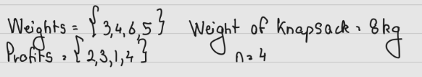
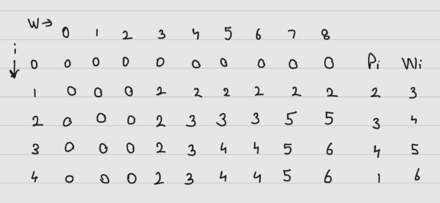

Slide 14
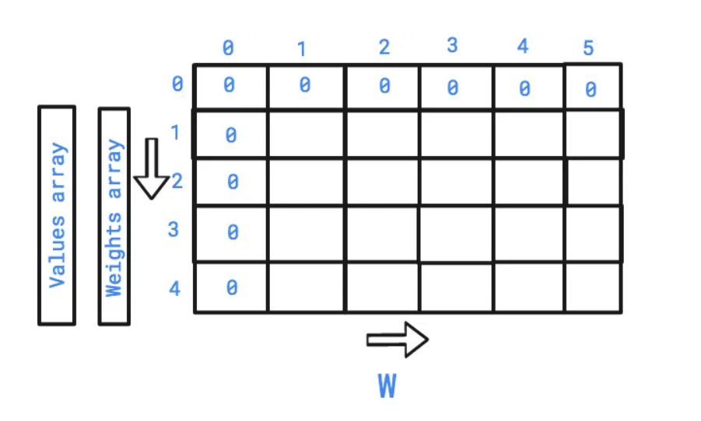
V [i − 1, j] if j < wi
(max(V [i − 1, j − wi] + vi, V [i − 1, j]) if j > wi

Slide 15
Applications
01
03
Financial Portfolio Optimization
Resource Allocation
02
04
Project Scheduling
DNA Sequencing

Slide 16


Conclusion
The Knapsack Problem is a fundamental optimization challenge with real-world applications in resource allocation, budgeting, and logistics.
The Knapsack Problem is a valuable tool for decision-making in diverse fields, enabling organizations to optimize resource utilization and maximize profit..

Slide 17
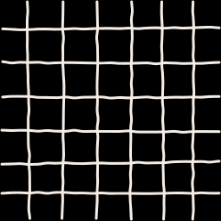

Thank you!

